Slide 1
PRINCIPLES OF RADIOLOGY

Slide 2
RADIOLOGY
Definition
Field of imaging utilizing X-rays from an X-ray tube
Different radiographic modes:
Survey (plain)radiography
Contrast radiography
Fluoroscopy
Computer tomography (C.T)
Digital radiography

Slide 3
Physical nature of X-rays
Electromagnetic radiation- -high energy and short wavelength-- λ in nanometers (nm)
Produced by collisions of first moving electrons between 2 atoms
The changing of energy levels in the orbit
Elements with high atomic number produce high energy radiation
Electromagnetic radiation do not need medium for transmission----vacuum

Slide 4
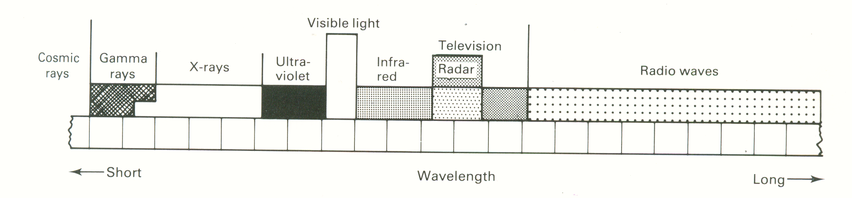


Electromagnetic radiation spectrum

Slide 5
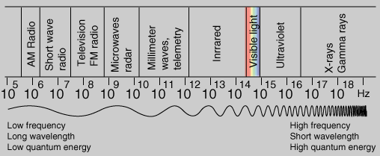
Electromagnetic radiation spectrum

Slide 6
Properties of x-rays
Linear emission
Invisible, odourless, tasteless
Intensity decreases with square of distance
Photographic effect
Fluorescent effect
Biological effects
Excitation and ionization of atoms esp. gas
High penetrating power

Slide 7
Properties of x-rays cont’d
Photographic effects
Photographic film
Latent image (invisible) seen b4 processing
“Real” (visible) image seen after processing

Slide 8
Fluorescent effect
Cause certain crystals to fluoresce
e.g. ca-tungstate, ZnS
Radiation within visible spectrum
This principle is used in:
Intensifying screens
Direct fluoroscopy imaging

Slide 9
Biological effects
Biological changes in living cells and tissues
By direct excitation and ionization
Excitation-electron change energy level
Ionization-complete removal and get +ve
Damage or kill cells
Somatic effects—short-term
Genetic effects—long-term

Slide 10
Penetrating power
The shorter wavelength
Attenuation-- gradual absorption as it passes thru an object
Influenced by:
Initial x-ray energy
Atomic number
Density
Thickness

Slide 11
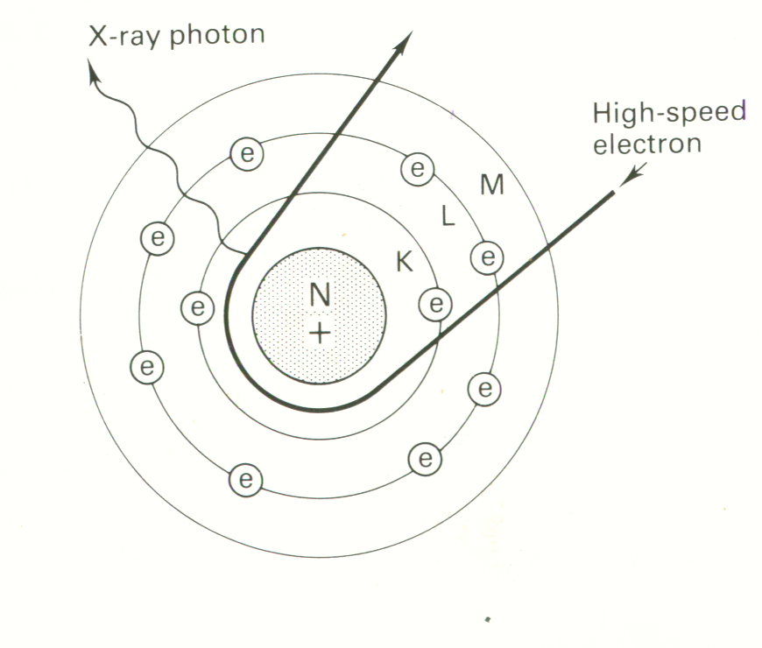
Production of X-rays
Fast moving electrons slowed or stopped
“Braking” (Bremsstrahlung) radiation-Electrons deceleration
99% heat
1% x-ray energy
Deceleration of electrons

Slide 12
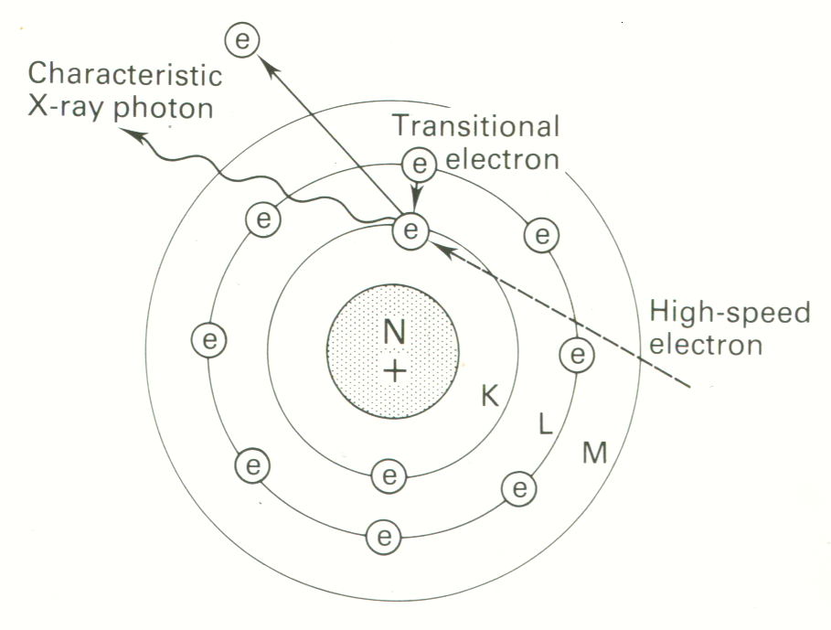
Production of X-rays
Fast moving electron from one atom
Collide with 2nd atom
Eject an electron
Vacancy filled by outer shell electron
Release characteristic radiation (x-ray photon)

Slide 13
X-ray tube
3 basic requirements for production of x-rays:
Source of electrons
Target that will stop the electrons
Method of accelerating the electrons
X-ray tube-- sealed vacuumed glass enveloped tube with 2 electrodes
The cathode
The anode

Slide 14
The Cathode
-ve charge
Source of electrons
Tungsten filament mounted on cup-shaped holder—focusing cup (nickel or molybdenum)
Heating with low tension circuit to emit electrons---Thermionic emission

Slide 15
The Cathode
-
Focusing cup
e-
e-
e-
Flowing to the target
Cathode
filament
Beam of
electrons

Slide 16
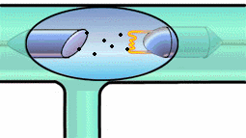
Movement of electrons from cathode to anode with x-ray beam production

Slide 17
The Cathode cont’d
Number of electrons ∞ Tº of filament
Higher No. for higher energy
Tube current in milliamperes (mA)
mAs for exposure time
Low tension circuit into high tension circuit for x-ray production = kilovoltages (kv)

Slide 18
The Anode
+ve charge
Tungsten target embedded in copper cylinder or disc
High positive potential relative to cathode
Potential difference measured in kv
Millions of collisions
A lot of heat
Faster electrons means high energy

Slide 19
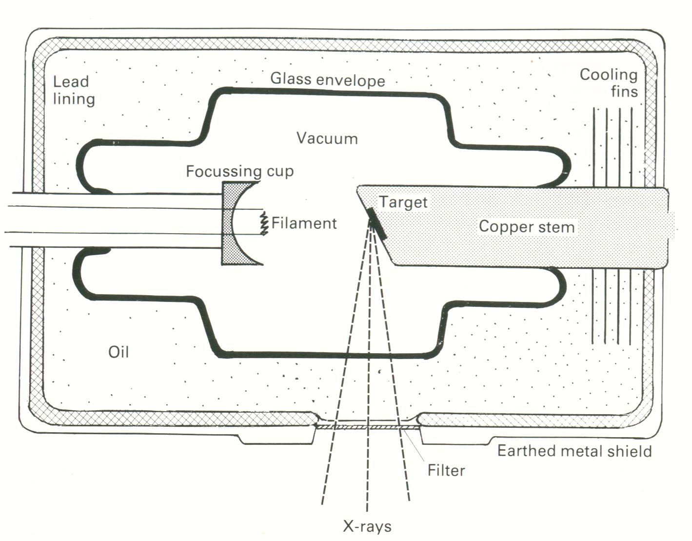
(sketch of x-ray tube)
The anode
e

Slide 20
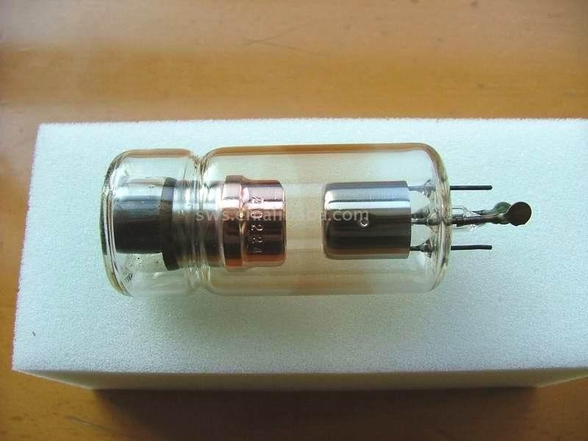
A model of an X-ray tube

Slide 21
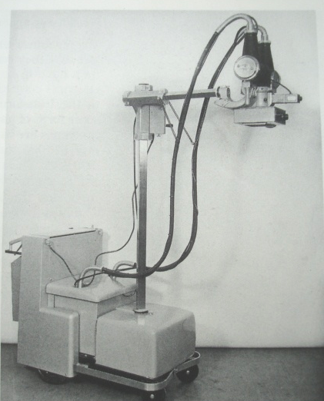
X-ray machine showing the tube
X-ray tube
X-ray tube window

Slide 22
The Anode cont’d
Tungsten melting point 3380ºc
Cu good heat conduction
In-built cooling devices with oil and metal fins
Fixed or rotating anode
Fixed –portable and dental x-ray units
Rotating—tungsten disc mounted on mb rod---3,000-10,000 rev/min—mobile/fixed

Slide 23

X-ray beam
Beam of electrons collide with target
Produce x-ray beam
Tube window or aperture
Hard and soft rays (1% + 99% heat)
X-ray beam
(99% heat + 1% x-rays

Slide 24
Factors affecting quality and intensity of x-ray beam
For production of x-rays, high voltage (kv) and low amperage (mA) is needed.
These 2 electrical properties determine quality and intensity of x-ray beam
Quality is a measure of penetrating power
Intensity is a measure of quantity/amount of x-rays

Slide 25
Factors affecting quality and intensity of x-ray beam cont’d
kv effect
High voltage potential between cathode and anode
High kv, more electrons and higher speed
High energy x-ray photons
Higher penetrating power of the beam
Affects both quality and intensity
Too high kv –cannot differentiate structures

Slide 26
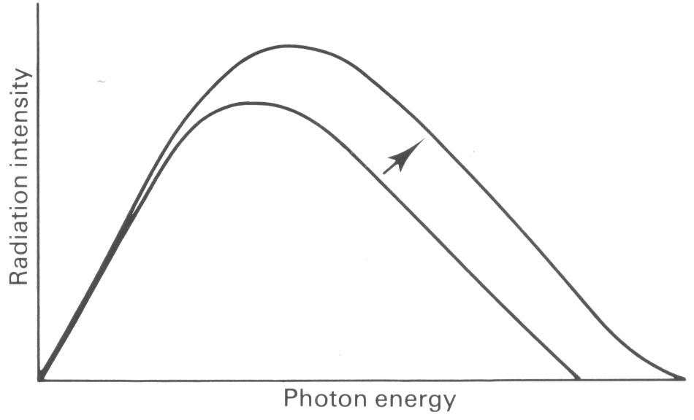
Effect of increasing kv on
X-ray beam

Slide 27
Factors affecting quality and intensity of x-ray beam cont’d
mA effect
Quantity of current passing across the tube
Depends on preheating temp of filament
No effect on quality of the beam
Affects intensity of the beam (quantity)
Selection of mA will automatically determine the cathode filament temp.

Slide 28
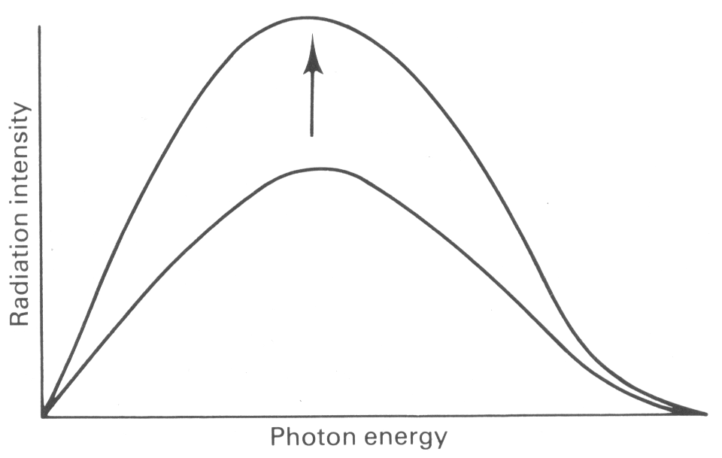
Effect of increasing mA on x-ray beam

Slide 29
Factors affecting quality and intensity of x-ray beam cont’d
Filtration effect
Filter across the tube window
Absorbs lower energy photons
Thin aluminium sheet
Result-- beam with small portion of low energy
Intensity of beam reduced
Good quality x-ray beam (less soft rays)

Slide 30
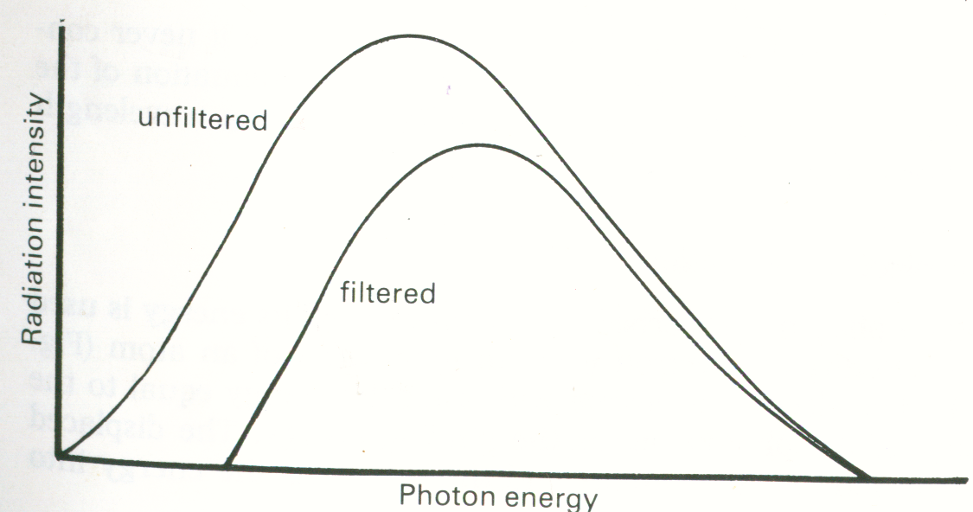
Effect of filtration on x-ray beam

Slide 31
Factors affecting quality and intensity of x-ray beam cont’d
Effect of distance
Affects intensity but not the quality
Increasing distance reduces intensity but no effect on quality of the beam

Slide 32
Effect of distance
The intensity of the beam falling on a given area is reduced to one quarter by doubling the distance from the point source.

Slide 33
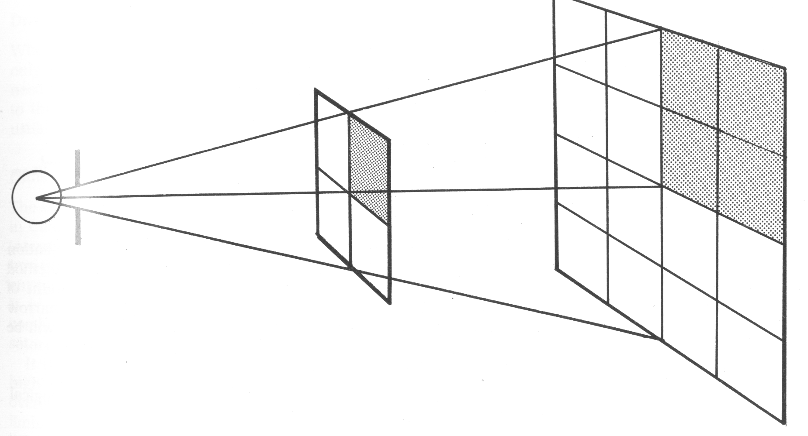
The intensity of the beam falling on a given area is reduced to one quarter by doubling the distance from the point source.
Doubling distance from beam source
Beam source

Slide 34
How X-rays interact with matter
Complete absorption
Attenuation---part absorption –reduced energy
Secondary or scattered radiation—produce lower energy photons divergent from 1˚ beam
Passing through
One passing thru produces sharper image

Slide 35
X-ray machines
4 main parts:
X-ray tube
Tube stand
Transformers
Control panel
Accessories to the x-ray machine
Protective implements
Grids and filters, cassettes and screens

Slide 36
Tube stands
Support of x-ray tube
Suspensions
Table top stands
Large floor mobile stands
Overhead ceiling mountings

Slide 37
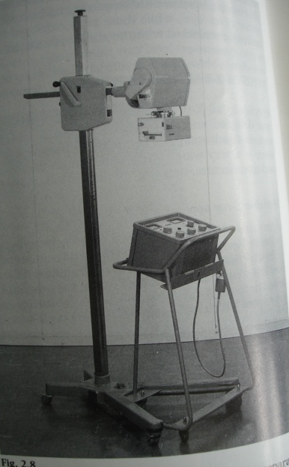
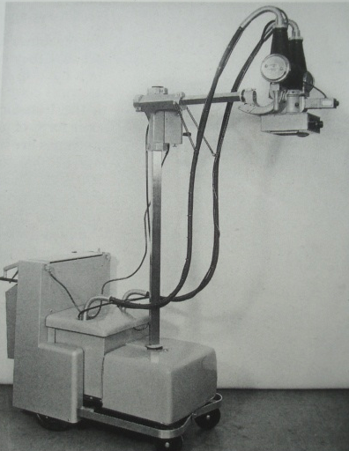
Tube stand
Tube stand

Slide 38
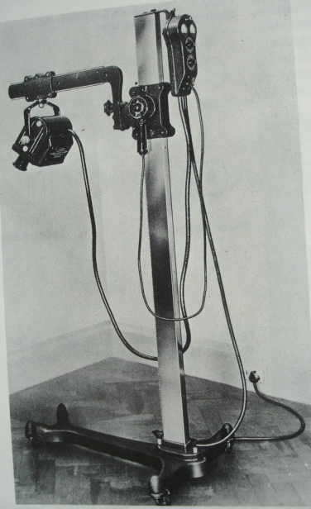
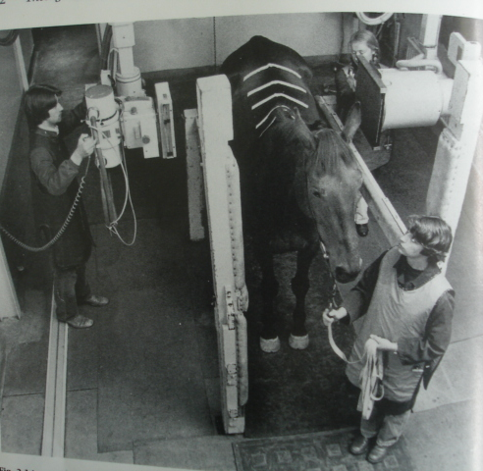
Tube stand

Slide 39
Control panel
On-off switch
kv selector
mA selector
Timer or exposure button
Exposure button is two-staged
Mostly operate together

Slide 40
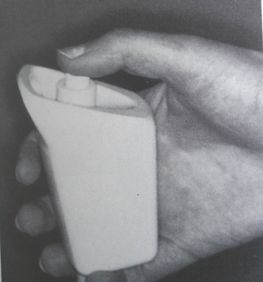
Control panel
Exposure button

Slide 41
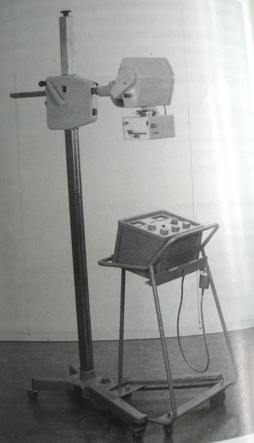
Example of portable x-ray machine
X-ray tube
Tube stand
Control panel of the
x-ray machine

Slide 42
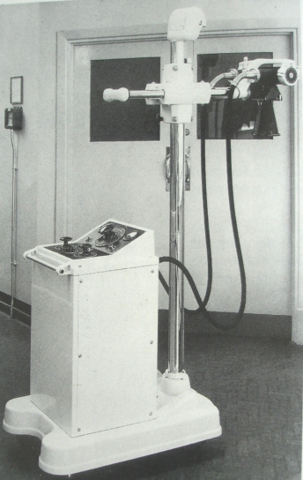
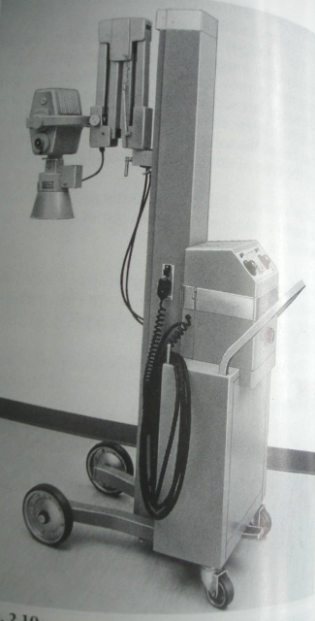
Mobile x-ray machines:

Slide 43
Specialized x-ray apparatus
Fluoroscopy imaging unit
Computer tomography scanner

Slide 44
X-ray beam
Composition
Hard rays
Soft rays

Slide 45
X-ray beam
Composition
Hard rays
Soft rays
-
CR
BEAM (soft + hard)

Slide 46
Collimation of the beam
Coning of the beam
Restricts divergence
3-fold purpose
    Prevent unnecessary radiation
    Reduce scattered radiation
    Minimize geometrical distortion
Lead plates (diaphragm)
Light source (“light beam diaphragm”)

Slide 47
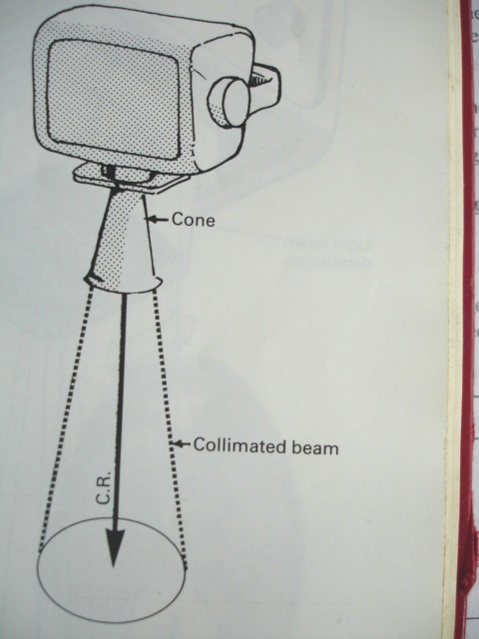
Coning of the beam
-

Slide 48





Coning of the beam
-
X-ray tube
Lead plates
(diaphragm)
The x-ray beam
X-ray film

Slide 49
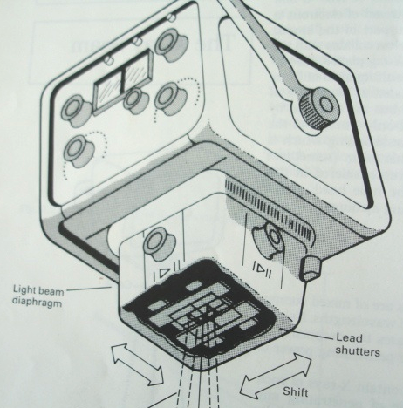
Coning of the beam

Slide 50
Differential absorption
All substances not penetrated equally
Substances allowing easy passage—radiolucent
Substances not allowing easy passage or blocking x-rays---radiopaque or radiodense
Depends on hardness or penetrating ability of incident beam---atomic number, density and thickness of the object

Slide 51
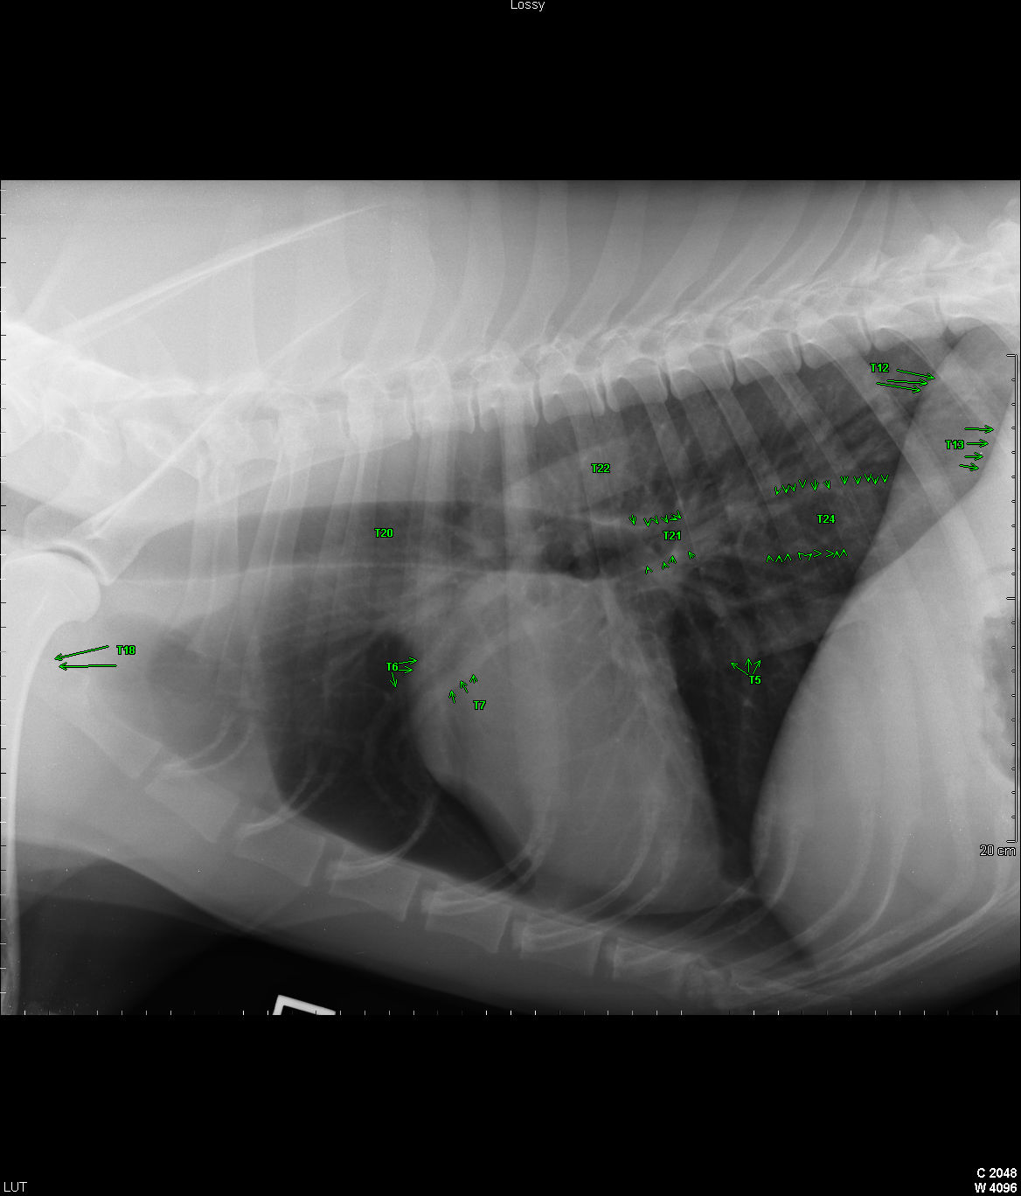
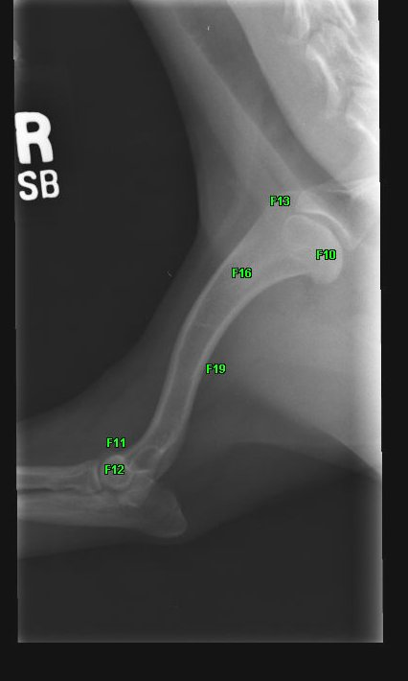
Differential absorption—influence on radiographic contrast (densities)

Slide 52
Differential absorption
determines radiographic contrast
Factors affecting differential absorption
Atomic number of different parts
Density of the object
Thickness of the object
Ag-halide→Ag + Halide + Ag-halide →black metallic Ag image (on processing)

Slide 53
Atomic number
Substance applied | Element | Atomic number
Soft tissue | H, C, N, O | Average 6
Bone | Ca, P---- | Average 14
Photographic emulsion | Silver and bromide | 47 and 35
Contrast media | Iodine and barium | 53 and 56
Tube target | Tungsten | 74
Shielding | Lead | 82
Air density | ---- | 0.0013

Slide 54
Differential absorption
X-ray tube
Adjustable lead
plates
X-ray beam
dso
Soft tissue
Bone
Object (structure)
Air
Air
X-ray film
Air
Soft
tissue
Bone
Soft
tissue
Air

Slide 55
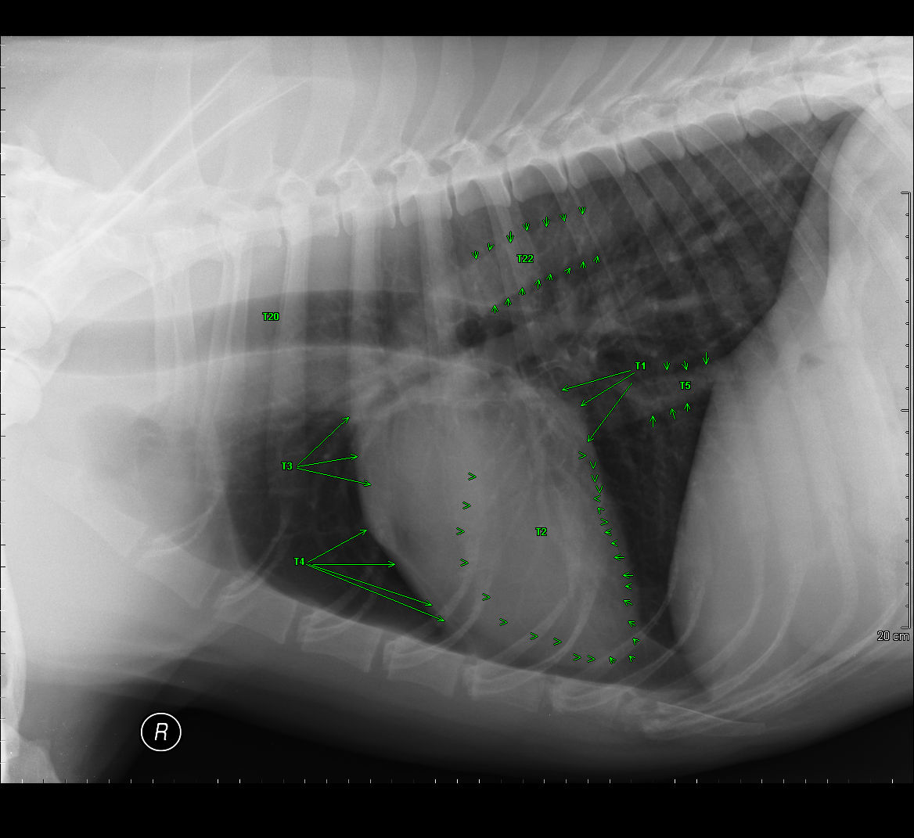
Differential absorption
Ribs
Trachea
Lungs
Heart
sternum
Air

Slide 56
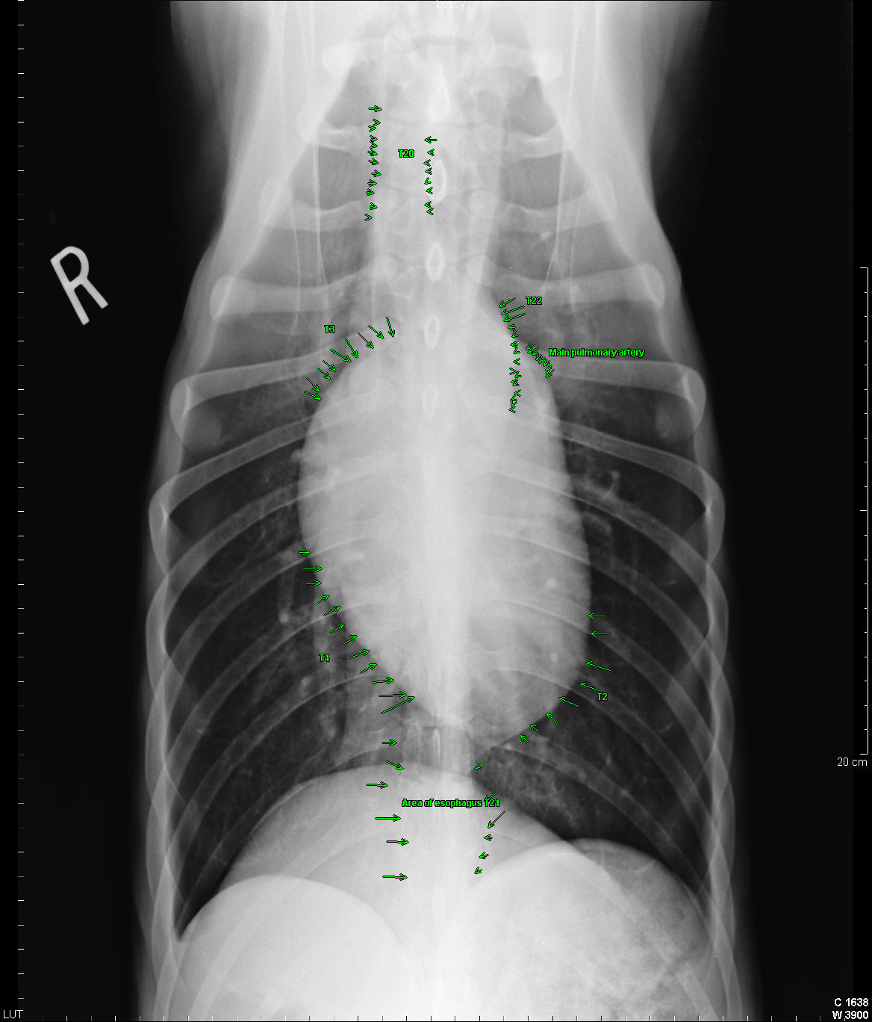
Differential absorption

Slide 57
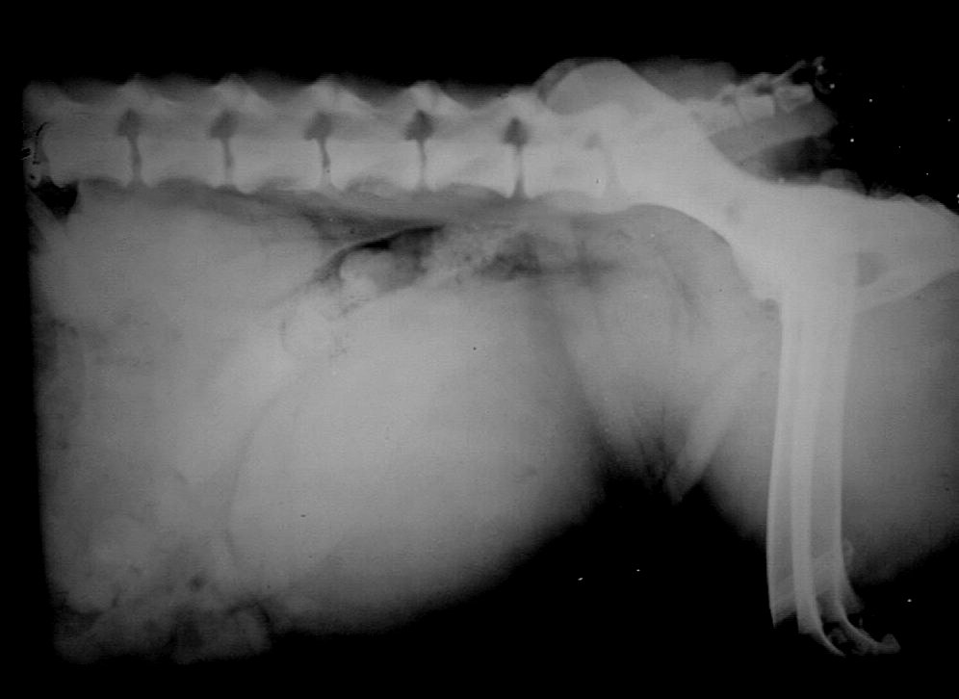
Differential absorption
Note the similarities of absorption in the abdominal viscera

Slide 58
Manifestation of the beam
Photographic effect
Latent and real image
Ag-halide→Ag + Halide + Ag-halide →black metallic Ag image
The more the x-ray beam reaching the film---the more the amount of Ag released--- the darker the image

Slide 59
Manifestation of the beam
Fluorescent effect
Crystals fluoresce at exposure to x-rays
Intensifying screens
cards coated with Ca-tungstate --blue-in the cassette
Fluoroscopy --direct screening-ZnS--green

Slide 60
Recording of X-ray image
X-ray film
Intensifying screen
Film sandwiched between 2 screens
-speeds exposure
-Reduce quantity of x-rays needed and exposure time
-loss of fine details
-screen film
-artifacts

Slide 61
Film cassettes
Light-tight
Smooth and rough faces
Intensifying screens
Different sizes
Unexposed corner

Slide 62
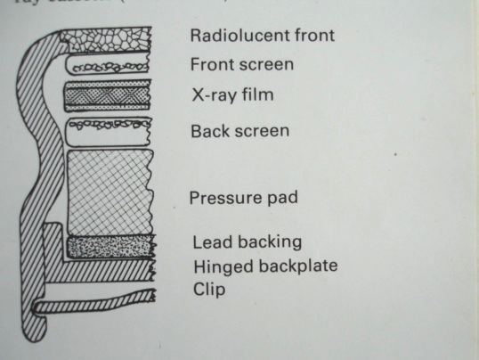
Cross-section of film cassette

Slide 63
X-ray films
Slow speed films =high detail
Medium speed films=standard or par-speed
Fast films = ultra-speed
Photographic emulsion –Ag-halide /gelatin
Direct exposure or non-screen
Screen films

Slide 64
X-ray films cont’d
Direct exposure (non-screen)
-fine details
-large silver halide grains
-longer exposure
-longer processing
-not good for automatic processors

Slide 65
X-ray films cont’d
Screen films
-loss of fine details
-thinner layer of Ag halide
-shorter exposure
-shorter processing

Slide 66
Handling of films
Unexposed
- properly sealed and protected from light
-protected from temp extremes, pressure and chemicals
-handled in the darkroom with safelight
Exposed
-off-loading, no light before processing
-no pressure in storage, no chemicals

Slide 67
Automatic processors
Temperature (25 -28˚C)
Time 90 sec
All steps including drying
Standard quality

Slide 68
Radiographic contrast
Differences in radiographic densities of images of various adjacent structures on the radiograph
Determined by:
Beam quality
Subject --atomic #, density, thickness
Film contrast
Processing factors--developing time and T˚

Slide 69
Radiographic contrast
Good contrast—good perception of structure differences and details
Poor contrast—inability to clearly perceive the structure differences and details
Factors causing poor radiographic contrast:
Overexposure
Underexposure
Overdevelopment

Slide 70
Radiographic contrast
Underdevelopment
Fogging and blurring:
  -Movement of tube, object, cassette (movement blur)
-Scattered radiation
Superimposition:
-Overlapping of images of structures depending on positioning and anatomy

Slide 71
Film identification
Radiograph must be identified
Patient particulars—spp, breed, sex, age, case # etc
Exposure factors written and enclosed
During radiography (exposure)
During processing (in the darkroom)
After processing when film is dry

Slide 72
Film identification
During radiography
Lead letters and numbers
Special radiopaque tape
After processing
Use of permanent waterproof markers

Slide 73
Radiographic positioning
Beam direction, C.R.(central ray)
Film positioning
Patient structure (object)
3-dimensional structure—2D image
At least 2 projections or views
Perpendicular to each other
C.R. perpendicular to the film

Slide 74
Radiographic positioning
Object as close to the film (OFD)
Magnification and distortion
Focal spot size
Actual focal spot and effective focal spot

Slide 75
Focal spot
Small focal spot a source of an x-ray beam gives the sharpest image
Large focal spot gives unclear image
Actual focal spot—area on the target receiving electron bombardment
3 times effective focal spot
Effective focal spot---area projected in the direction of the x-ray beam

Slide 76
Actual focal spot and effective focal spot
-
Cathode
Anode target
Actual focal spot
Effective focal spot

Slide 77



OFD
Object closer to the film
Sharper image

Slide 78


OFD
Object film distance large gives magnified and
Geometrically distorted image

Slide 79
Focal spot
Small and large focal spots
Point source
focal spot
Large focal spot
Object
Penumbral
effect
Image not sharp
Sharp image
X-ray film

Slide 80
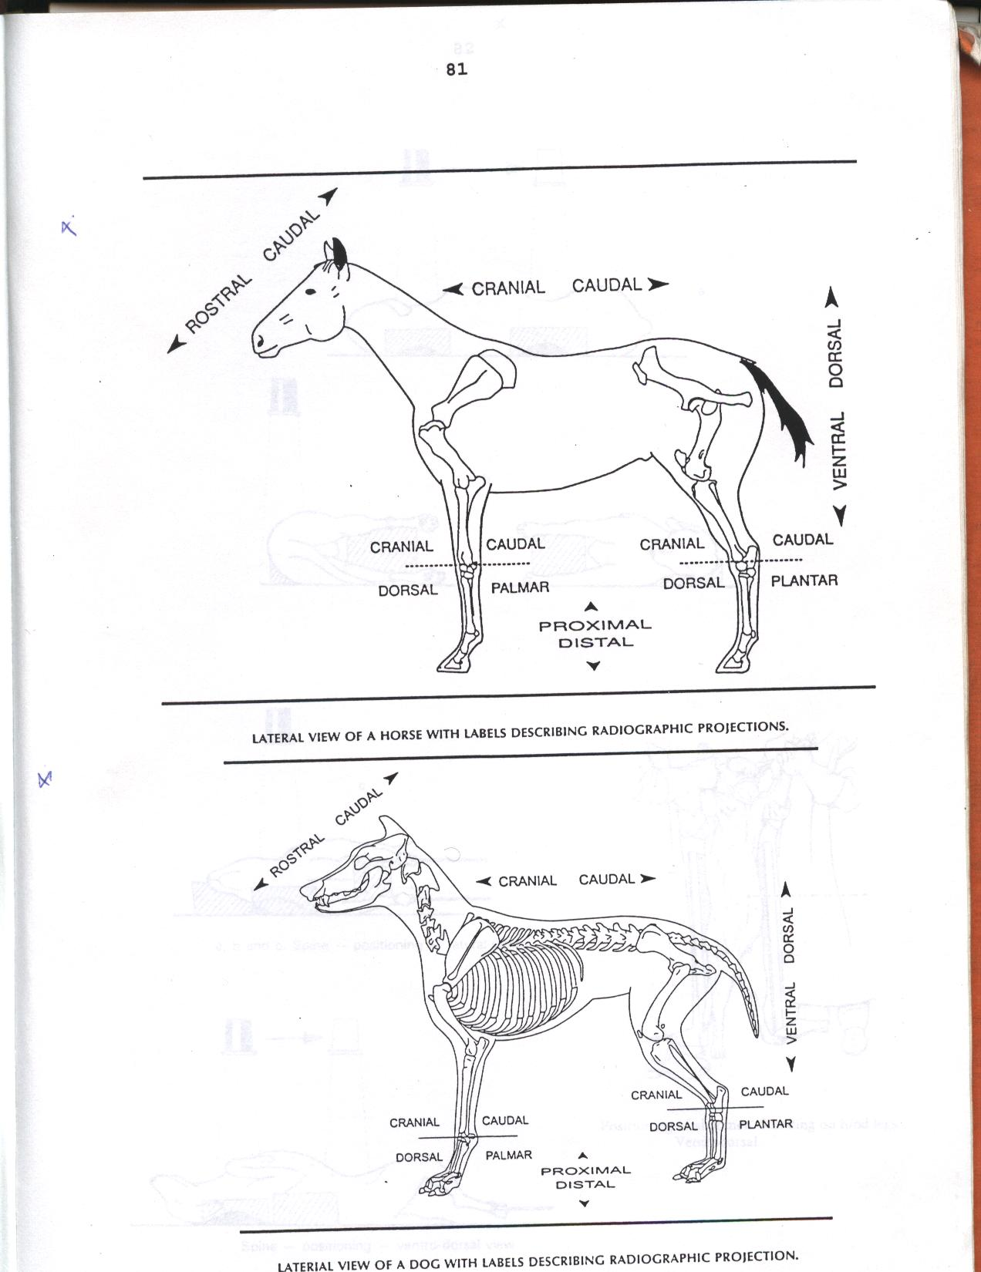
Radiographic positioning
Various radiographic views (projections):

Slide 81
Radiographic positioning
Various radiographic views

Slide 82
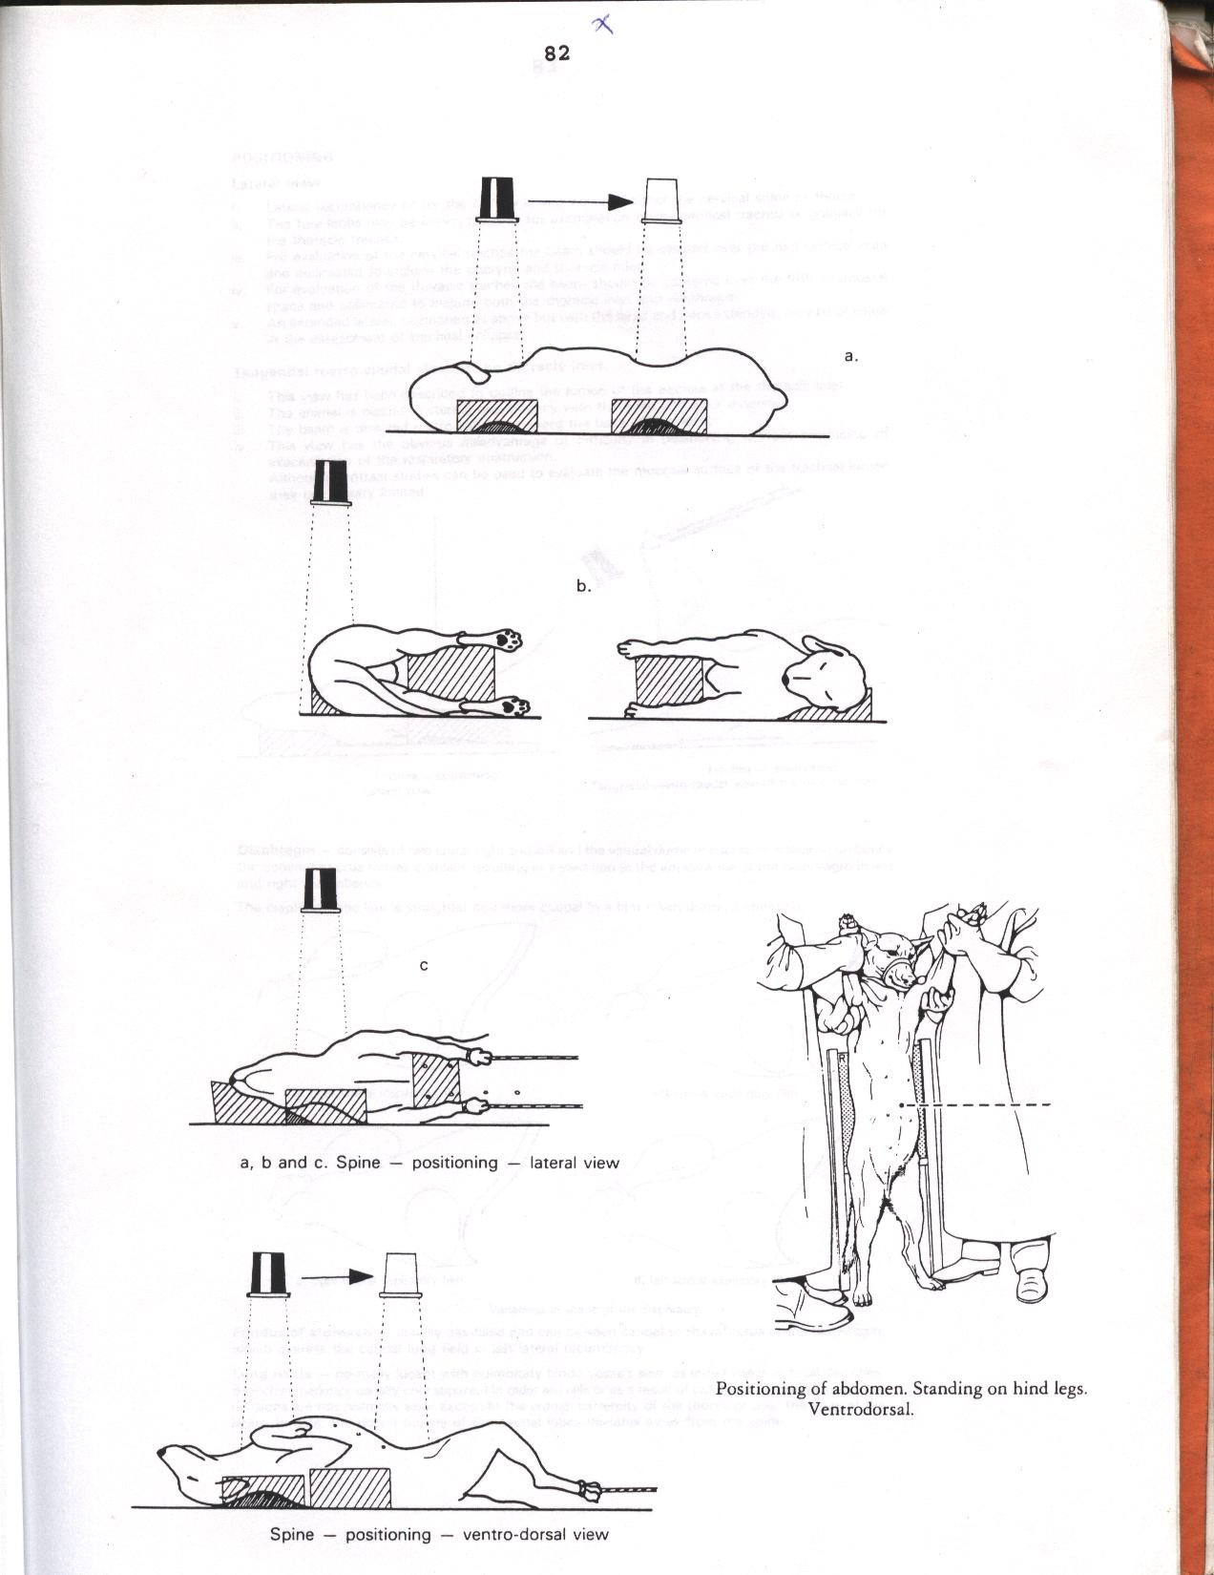
Radiographic positioning
Lateral view of neck and abdomen

Slide 83
Radiographic views
Lateral view
Lateral-medial/medial lateral
Ventro-dorsal (VD)
Dorso-ventral (DV)
Cranio-caudal/antero-posterior (AP)
Caudo-cranial/postero-anterior (PA)

Slide 84
Radiographic views
Dorso-palmar
Dorso-plantar
Rostral-caudal
Oblique views
Joint flexion view

Slide 85
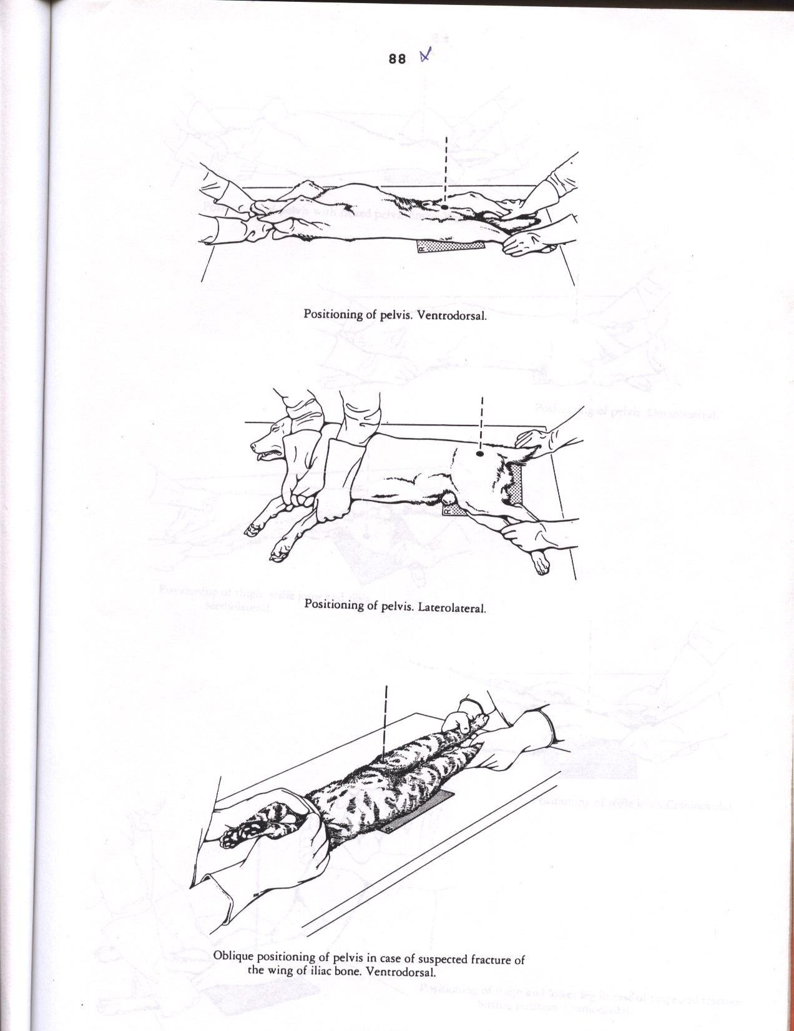
Radiographic positioning
-
Ventro-dorsal view of the pelvis

Slide 86
Radiographic positioning
Lateral view of the pelvis

Slide 87
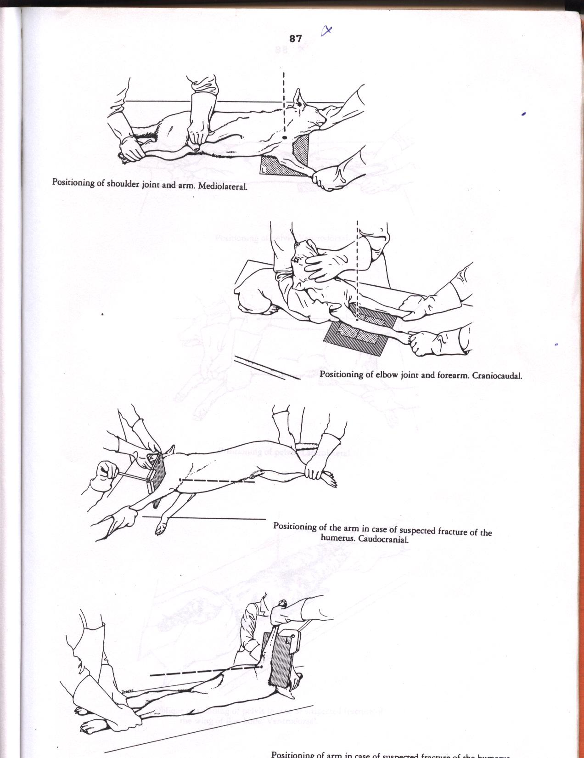
Radiographic positioning
-
Positioning for lateral view (medial lateral) of the shoulder joint

Slide 88
Radiographic positioning
-
Cranio-caudal view of the elbow joint

Slide 89
Radiographic positioning
-
Caudo-cranial view of the elbow

Slide 90
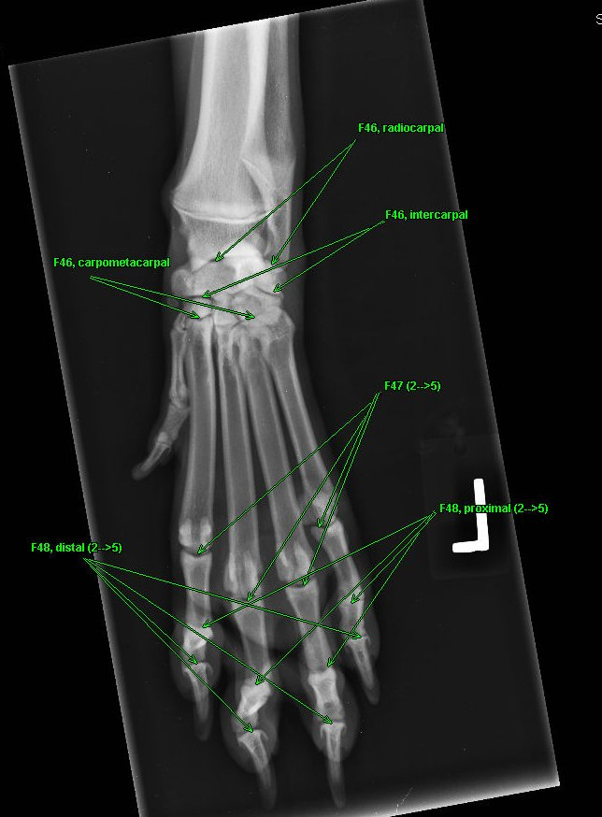
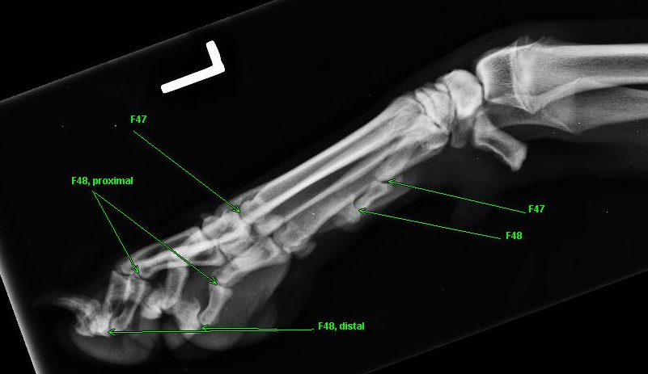
Superimposition in positioning

Slide 91
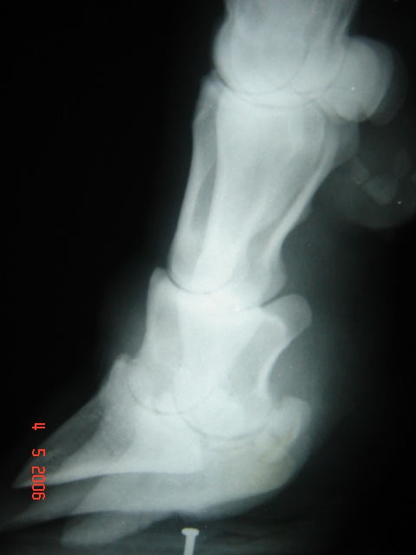
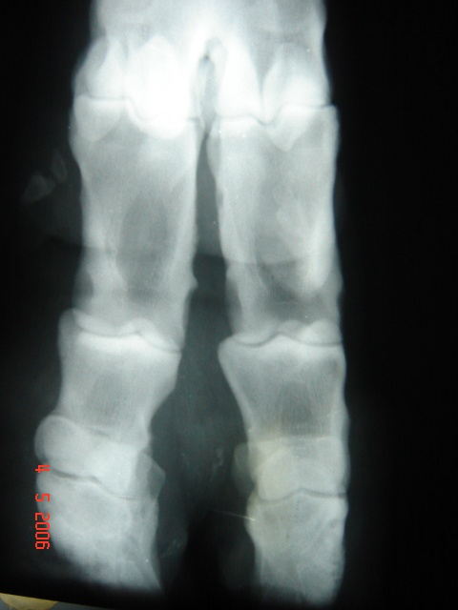
Superimposition in positioning

Slide 92
Contrast radiography
Elective alteration of densities of organs and structures
Delineate whole organ and structural details
Similar inherent densities
Survey (plain) radiography cannot reveals the distinction and the details
Use chemical agents= contrast media

Slide 93
Contrast radiography
Positive contrast----use of high atomic number chemicals
Negative contrast----use of low density chemicals ---usually gases/air

Slide 94
Positive contrast radiography
Increase radiopacity
Barium sulphate preparations for the alimentary tract
Suspension, colloidal or viscous paste
Barium swallow---oesophageal examination
Barium meal---stomach, intestine
Barium enema--- rectum, distal colon
Alone or with ground food

Slide 95
Positive contrast radiography
Barium swallow—serial exposures

Slide 96
Positive contrast radiography
Barium meal—serial exposures essential

Slide 97
Positive contrast radiography
Barium enema—serial exposures essential

Slide 98
Positive contrast radiography
Injectable positive media
Water soluble iodine compounds
  Low toxicity and irritancy
  Conray “420” or Conray “280”
  Sodium diatrizoate or meglumine diatrizoate
  Sodium iothalamate or meglumine iothalamate
  Sodium metrizoate/meglumine metrizoate

Slide 99
Positive contrast radiography
Intravenous urography (IVU)---contrast radiography of urinary tract particularly kidneys and ureters
Intravenous contrast media rapidly excreted thru kidneys
Rapid radiography after i.v. injection
Pyelography (IVP)—define renal pelvis
Nephrography –renal medulla

Slide 100
IVU
Low volume rapid injection technique---better for investigation of the kidneys.
High volume drip infusion technique---good for ureters
Serial exposures at various time intervals

Slide 101
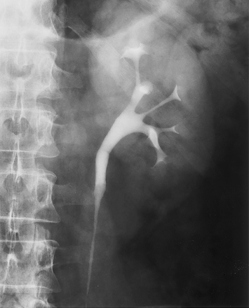
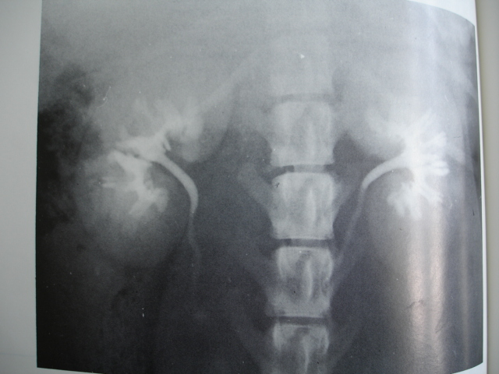
IVU

Slide 102
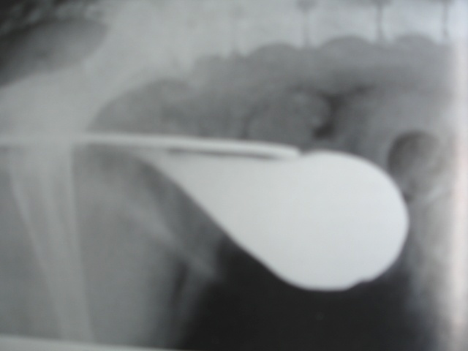
Positive contrast radiography
Cystography---contrast examination of the urinary bladder
Use of water soluble iodine compounds--retrograde

Slide 103
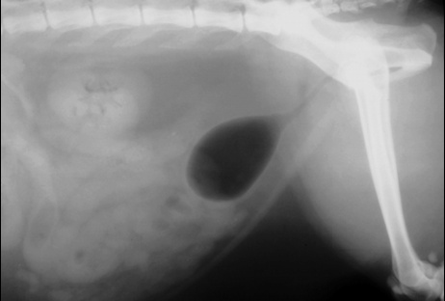
Pneumocystography
Negative contrast examination of urinary bladder
Increase radiolucent appearance
Double contrast

Slide 104
Other forms of positive contrast
Urethrography
Bronchography
Myelography
Angiography
Arteriography and veoga
Angiocardiography
Cholecystography
Arthrography and sialography

Slide 105
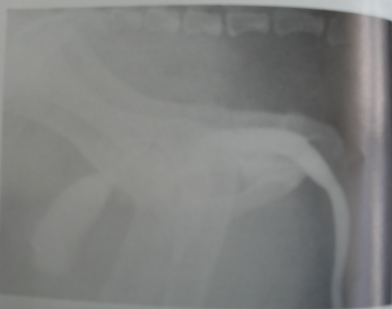
Urethrography

Slide 106
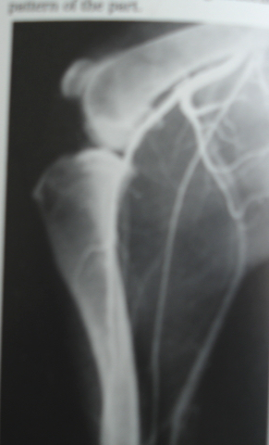
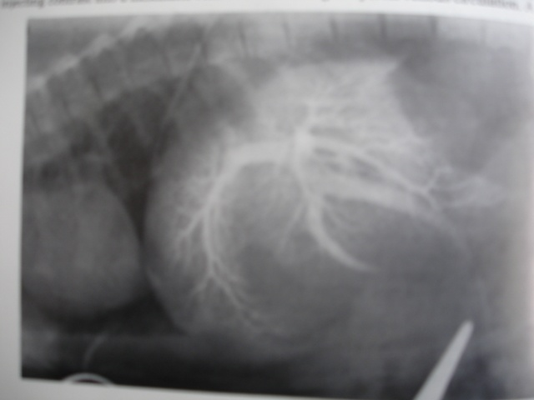
Angiography and portal venography

Slide 107
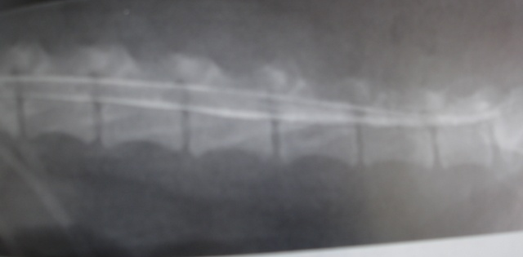
Myelography

Slide 108
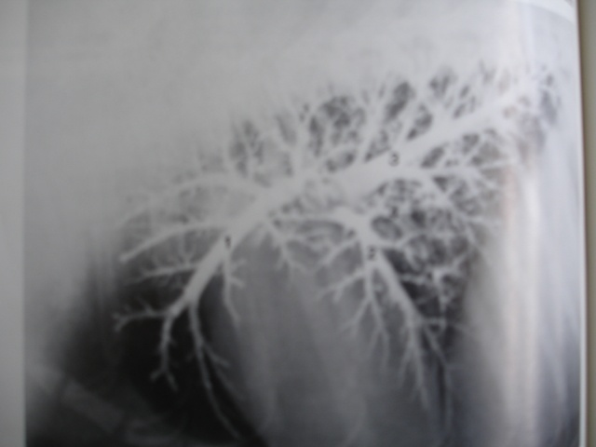
Bronchography

Slide 109
Scattered radiation
Secondary radiation
Different direction from primary beam
Soft radiation
Causes blurring of the image
Sources of scattered radiation

Slide 110
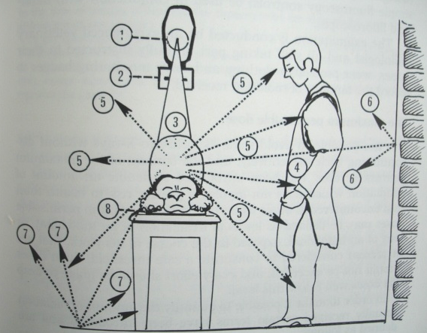
Scattered radiation

Slide 111
Methods of cutting down scattered radiation
1.The grid
Parallel grid (linear grid)
Grid cut-off
Grid factor –compensation by increased mA

Slide 112
Parallel grid
--
Beam
Grid
Film

Slide 113
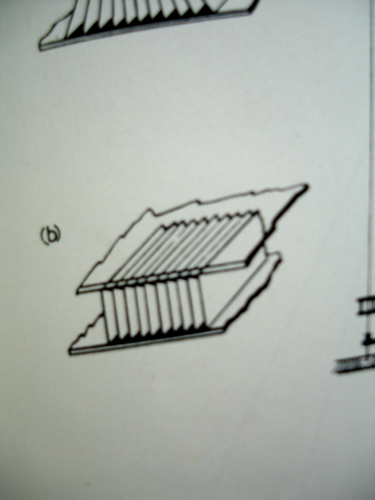
Parallel grid
-

Slide 114
Focused grid
--
Beam
Grid
Film

Slide 115
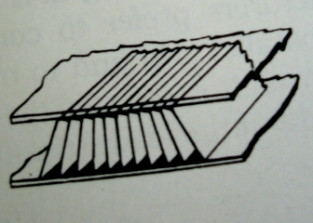
Focused grid
--

Slide 116
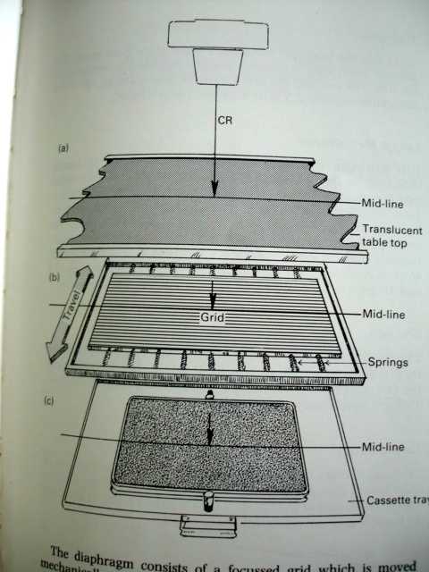
Grid positioning

Slide 117
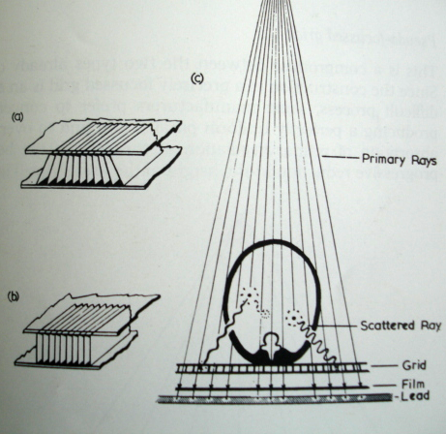
Grid positioning

Slide 118
Cutting down scatter radiation
2. reducing the amount of tissue penetrated
Collimation of the beam
Abdominal compression
3. Prevention of back scatter
Lead at the back of the cassette
4. After meeting all other basic requirements, kv should be as optimally low as can be

Slide 119
Radiation safety
Radiation injury:
Affects most prolific and highly reproducing cells
Embryos, fetuses, reproductive and gonadal cells, skin, bone marrow cells, young individuals < 16 years
Single large dose or small cumulative doses

Slide 120
Radiation safety cont’d
Forms of radiation injury:
Somatic effects---short-term—burns, carcinogenic
Genetic effects---long-term---alteration in DNA constitution---mutations

Slide 121
Radiation safety cont’d
Sources of damaging radiation:
X-ray apparatus
Tube head- filtration, coning
Primary beam
Scatter radiation
Direct screening through fluoroscopy

Slide 122
Radiation safety cont’d

Slide 123
Radiation safety cont’d
Maximum permissible dose
Levels of irradiation of an individual or part of an individual exposed in the course of duty currently considered as safe threshold.
All efforts to keep doses below this level.
Absorbed dose---quantity of energy imparted by ionizing radiation to matter per unit mass of the matter

Slide 124
Radiation safety cont’d
Dose equivalent---obtained by multiplying the absorbed dose in tissue by the quality factor
Quality factor for x-rays is 1
(Numerically) dose equivalent = absorbed dose

Slide 125
Monitoring exposure to radiation
Mandatory according to radiation protection boards
Ionization chambers or ionization dosimeters:
Small ionization chambers mounted in x-ray rooms or carried by staff (pen size clipped to clothing)
Measures the quantity of electric charge generated per mass unit of irradiated air
Film badges: small light proof holders worn by the staff---tiny films

Slide 126
Monitoring exposure to radiation
Processed at given periodic intervals—film blackness
Thermoluminescent dosimeters-
contain compounds eg lithium fluoride, calcium fluoride---intensity of fluorescent light when heated is proprotional to radiation received before heating

Slide 127
Radiation safety cont’d
Premises :
Clearly marked and suitable room and warning lights and signs
Restricted to staff only
Comply with safety requirements

Slide 128
Protective clothing
Aprons or Gowns:
Plastic impregnated with lead
Protect from shoulder to knee region
About 0.25 mm of lead equivalent
Single-sided or double-sided
Not to be folded but hang straight

Slide 129


Wearing and storage of the gown

Slide 130
Protective clothing
Lead gloves
Lead screens:
mobile or fixed lead shields with lead glass window
Protection to the radiographers
Personnel:
Trained competent persons
An in-charge to enforce rules and check the equipment---written instructions

Slide 131
Radiographic viewing and interpretation
History
Clinical examination
Anatomy
Superimposition
views

Slide 132


Thoracic lateral and VD radiographs
Exposure at inspiratory pause

Slide 133

Thoracic lateral radiogrph
Ld
AO
Rd
T
CV
LA
RA
LV
RV
Notes:
CV
CV
CV

Slide 134

Abdominal lateral radiograph

Slide 135

Abdominal radiograph - lateral

Slide 136


Thorax and abdomen

Slide 137


Bone reaction

Slide 138


Bone neoplasia

Slide 139


Slide 140


Slide 141


Slide 142


Slide 143


Slide 144


Slide 145


Slide 146


Slide 147


Slide 148


Slide 149


Slide 150


Slide 151


Slide 152


Slide 153


Slide 154


Slide 155
FLUOROSCOPY
Study of body parts in motion (for function evaluation of moving body parts)
Utilizes x-rays from an x-ray tube
Can be used with contrast media or dye
Determines function of the organ
Use of a screen—similar to T.V. monitor
Screen contains fluorescent crystals—Zinc cadmium sulphide

Slide 156
FLUOROSCOPY
Screen positioned in the way of x-ray beam after the beam traverses the patient
Vascular catheterization may be needed depending on the body structures being examined----for injection of a dye or contrast media to enhance details

Slide 157
FLUOROSCOPY
A constant stream of x-rays pass through the patient and the shadow image is cast onto the screen
Reveals less details than the standard still radiographs
Exposes the patient to more doses of x-rays than the standard still x-rays
Should be done only for motion function investigation

Slide 158
FLUOROSCOPY
Darkened room enhances appreciation of image details
Image intensifier enhances visualization of the image details---increases the brilliance of the image
x-ray tube under the table or sideways

Slide 159





Fluoroscopy arrangement
Still camera
TV camera
Image intensifier
Monitor
Patient
X-ray table
X-ray tube

Slide 160


FLUOROSCOPIC IMAGE
Movement of the large bowels (the colon)

Slide 161
DIGITAL RADIOGRAPHY (DR)
Film-based imaging system employs ability of the film emulsion to register presence of x-rays
Digital imaging systems employ the use x-ray detectors to transmit data which are electronically converted into image capture, recorded and viewed on computer monitor

Slide 162
DIGITAL RADIOGRAPHY cont’d
Advantages:
- image can be adjusted using computer software to maximize diagnostic image quality
- digital images can be accessed at several computer workstations within the hospital
- digital images can be instantly retrieved from computer archives

Slide 163
DIGITAL RADIOGRAPHY cont’d
  -Digital images can be transmitted via internet for consultation or case referral
  -Digital image is acquired faster when compared to conventional film radiography which undergoes longer processing
  -Digital radiography reduces the need for “retake” of radiographs because of the wide latitude in exposure factors
  - Eliminate costs of film development

Slide 164
DIGITAL RADIOGRAPHY cont’d
Disadvantages of DR:
These are minimal compared to advantages
The need for specialized training and skill of adjusting to DR imaging system
Image manipulations dependent on individual computer and radiographic skills
Exposure errors and poor radiographic techniques cannot be corrected by computer image manipulation skills
Excessive computer image manipulations can create artifacts

Slide 165
DIGITAL RADIOGRAPHY cont’d
Currently available digital radiography systems:
-computer radiography (CR)
-direct digital radiography (DDR)
Conventional film cassette is replaced by a reusable image receptor (detector)
X-ray tube, generator and peripheral x-ray machine hardware are the same for conventional and DR imaging

Slide 166
DIGITAL RADIOGRAPHY cont’d
After x-ray exposure, digital image is made and transferred to a dedicated DR computer called the “acquisition station”, which is used for digital imaging processing
At the acquisition station the image can be adjusted for proper contrast and latitude (shades of grey).
Corrections of minor over- or underexposure, orientation, cropping and masking etc

Slide 167
DIGITAL RADIOGRAPHY cont’d
The processed digital image is “finalized” and then sent to another dedicated computer workstation for diagnostic interpretation
The “finalized” is permanent
In large hospitals, digital images are sent to a main centralized computer (a server) for storage ad distribution to multiple workstations.

Slide 168
Computed radiography (CR)
In CR, an imaging plate rather than an x-ray film is used to record or store x-ray energy as latent image to be “read-out” later
Imaging plate is stored in a cassette with similar physical appearance as a conventional film cassette, but is coated with photostimulable phosphors (PSP) (layer of crystals)
Because PSP plates store x-ray energy, they are also termed “storage plates”
CR requires specialized “image reader device (IRD)” or “plate reader”

Slide 169
Computed radiography (CR) cont’d
The CR cassette is placed into the CR reader, where the plate reader automatically extracts the CR plate (PSP plate) from the cassette
The plate reader (processor) scans the CR plate with helium-neon laser
During scanning, the laser stimulates release of trapped (stored) x-ray energy (the latent image) in the CR plate as visible light (phosphorescence)
The emitted light is transmitted through a fiber optic system to a photomultiplier tube (PMT) in the reader, which detects it

Slide 170
DIRECT DIGITAL RADIOGRAPHY (DDR)
Uses imaging plate with detector elements
2 main types of detectors:
Direct and indirect
Indirect detectors- convert x-ray energy into light, which is in-turn converted to an electrical signal.
Direct detectors-convert x-ray energy directly to an electrical pulse
Imaging plate for DDR is built directly into the x-ray table or is portable and does not require a cassette.

Slide 171
DDR cont’d
DDR plate is connected directly to a computer
Intensity of light or elctrical pulse is digitized, and the digital image is available almost immediately viewing on a monitor (4-10 seconds) for quality control
When acceptable, the image is transferred to a storage computer, where it is available for viewing and interpretation on a workstation as with CR.
Film printing requires a suitable printer and special paper

Slide 172
DR artifacts
Overexposure and underexposure
CR image plates can crack as they bend inside the plate reader. Cracks show as white lines.
Debris within the CR cassette such as dirt or hair will block light and appear as white linear artifacts
Plate reader artifacts when CR plate has been improperly erased
Ghost images from extraneous radiation from scatter radiation can cause CR image fogging
Operator errors e.g. improper placement of equipment like flat panel detectors, grid and motion

